Slide 1
All About PACMAN!
1772044 – Roy Parsaoran
1772045 – Eggy Herlandi
1772046 – Ariyanto Sani
1772049 – Arief Kurniawan
パックマン

Slide 2
Pokok Pembahasan!
History
Facts & Achievements
Game
Conclusion

Slide 3
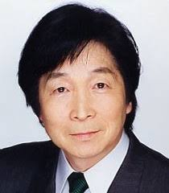
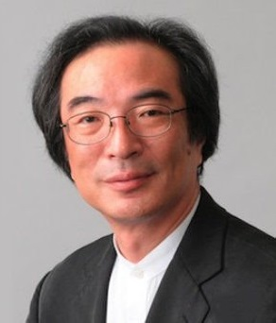
The Founders!
Hello!o
甲斐 敏夫
Toshio Kai Composer
岩谷 徹
TORU IWATANI Designer
舟木 茂雄
Shigeo Funaki Programmer

Slide 4
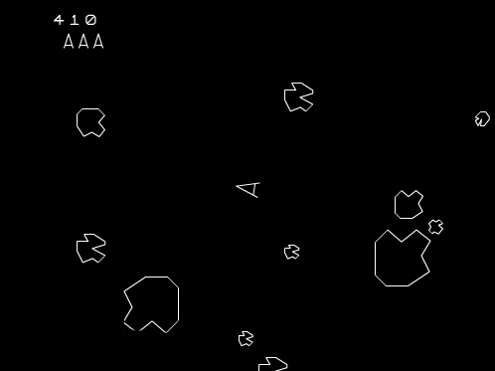
Pac-Man Rilis di jepang pada tanggal 22 Mei 1980.

Slide 6
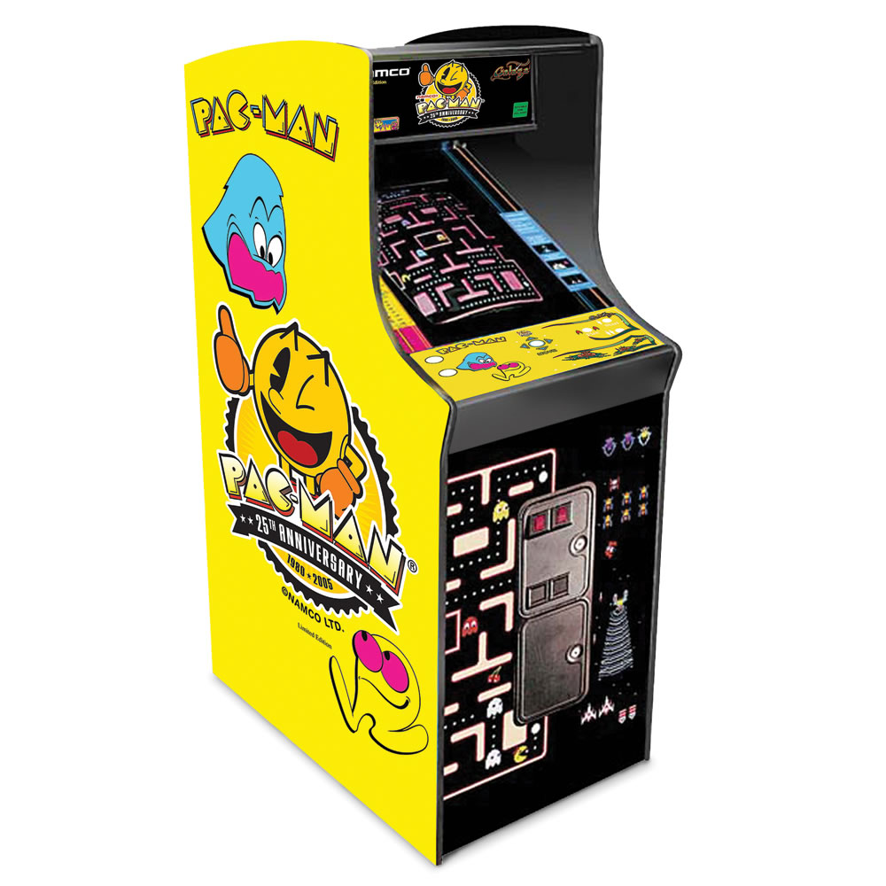

Slide 7
Setelah Mendengar Kesuksesan dari Pac-Man, Perusahaan Manufaktur Game (Midway) mencoba Membawa Game ini ke pasar Amerika Serikat

Slide 8
Dan pada tahun yang sama di bulan Oktober, Pac-Man Rilis di United States

Slide 9
Pac-Man
Puck-Man

Slide 10
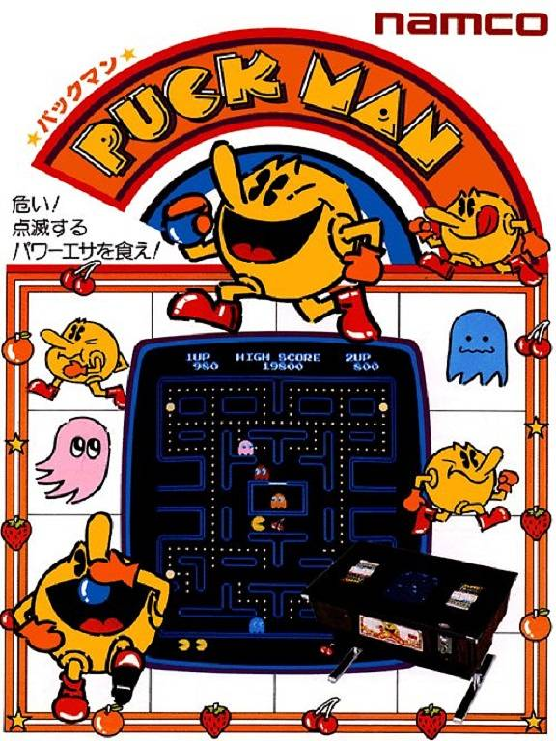
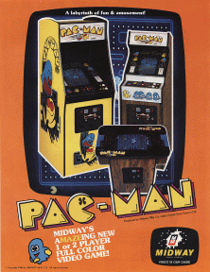

Slide 11
SOCIAL PHENOMENON

Slide 12
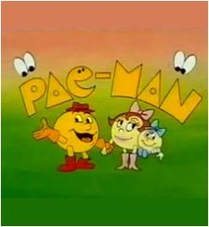
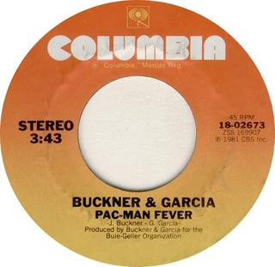
Pac-Man (TV Series)
Pac-Man Fever Song

Slide 13
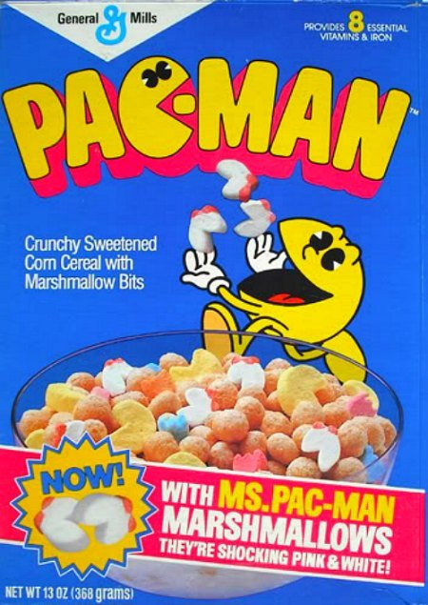
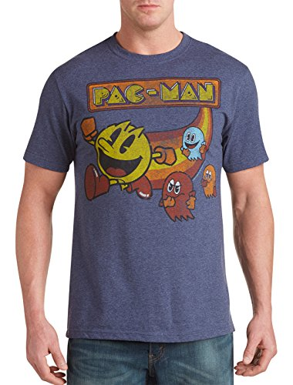
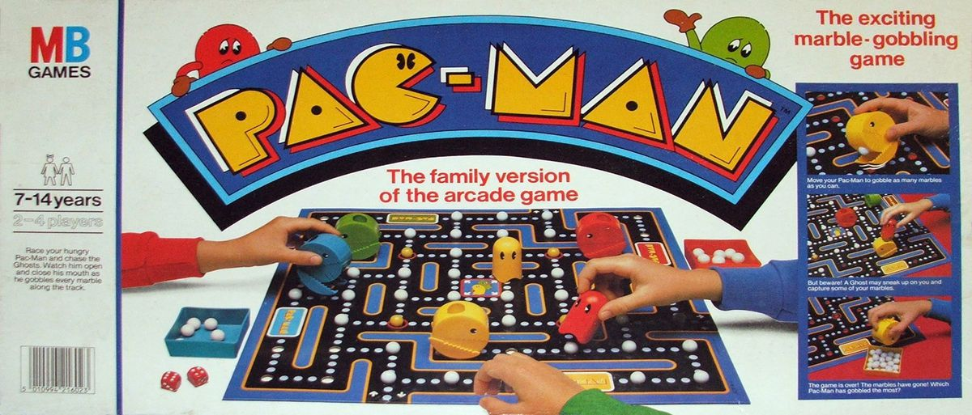

Slide 14
FACTS! & ACHIEVEMENTS

Slide 15
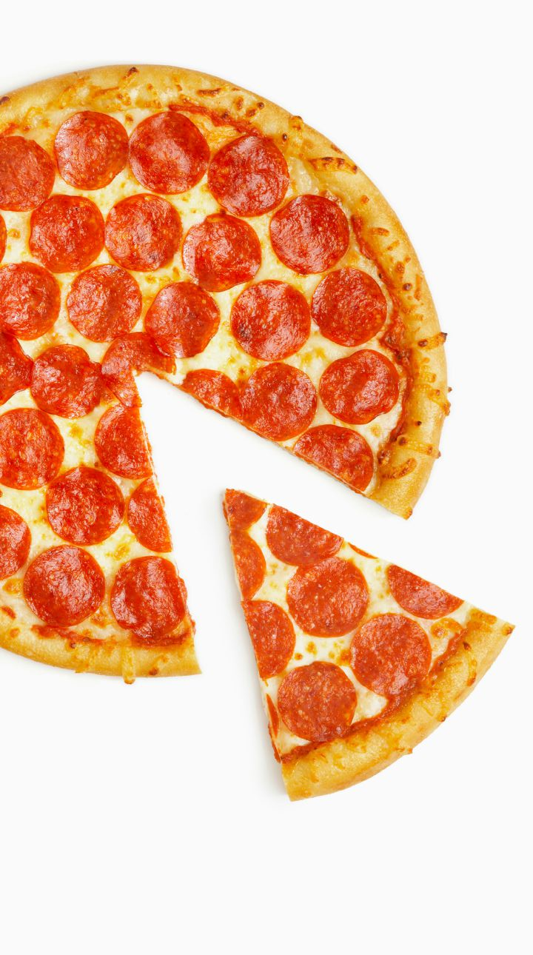
Its shape is Inspired by a pizza missing a slice!

Slide 16
Enemies:
Akabei
(赤ベイ)
BLINKY
Guzuta
(愚図た)
CLYDE
Aosuke
(青助)
INKY
Pinky
(ピンキー)
PINKY

Slide 17
Pac-Man / パックマン
❤
❤
❤
According to the Davie-Brown Index, Pac-Man has the highest brand awareness of any video game character among American consumers, recognized by 94 percent of them.

Slide 18
DID YOU KNOW? Pada saat Pacman merayakan ultahnya yang ke 30, google menambahkan game tersebut kedalam koleksi Doodlenya.

Slide 19
293,822
1980-1987
Whoa! That’s a big number, aren’t you proud?

Slide 20
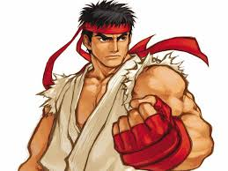
3 Most Successful Arcade Games
White
Black

Slide 21
TOP 3 Biggest Grossing Arcade Games
 | Cabinets Sold (All Time) | Revenue by 1995 | Inflation Adjusted
PAC-MAN | 400,000 | $3,500,000,000 | $7,681,491,635
Space Invaders | 360,000 | $2,702,000,000 | $6,612,228,000
Street Fighter II/ Champion Edition | 200,000 | $2,312,000,000 | $3,582,553,228
That’s a lot of money!

Slide 22
GAME!

Slide 23
Conclusion About PAC-MAN
Was A Social Phenomenon rather than just an Arcade Game
Most Successful Arcade Game of all time
Most recognized Video Game Character in the United States

Slide 24
THANKS!

